Slide 1

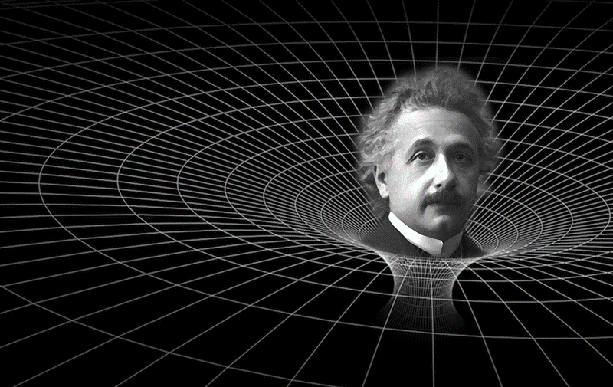

Thin Shells as Neutron Stars: A Simple Stellar Model with Great Insight
Phil LeMaitre, Eric Poisson
Based on our paper: “Equilibrium and stability of thin spherical shells in Newtonian and relativistic gravity”. arXiv:1909.06253., which has been accepted for publication in the American Journal of Physics
Notes:
- Introduce model as an accreting Neutron star in a binary system with a much smaller mass object (so it doesn’t perturb the neutron star very much)

Slide 2
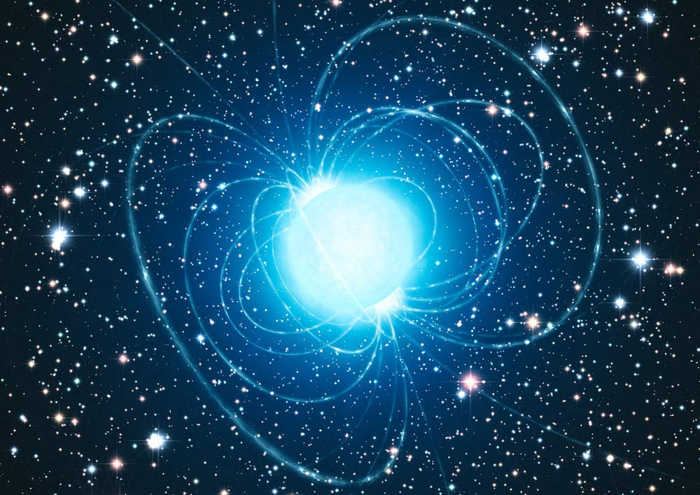
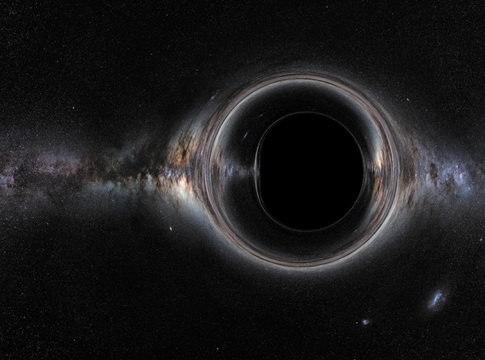
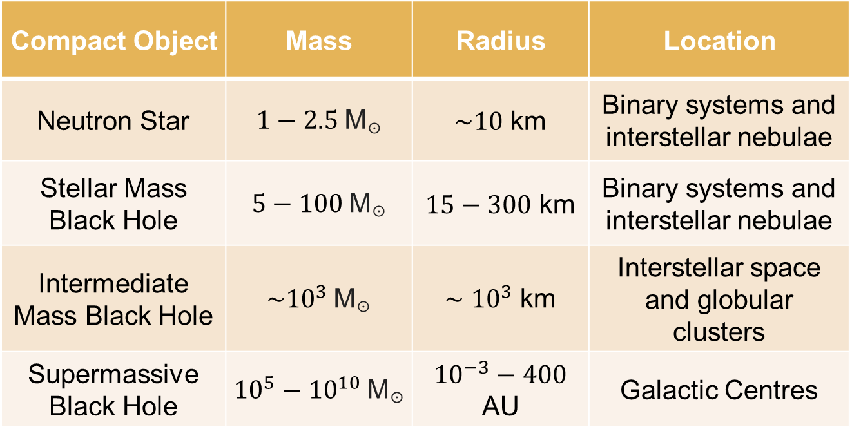
Compact Objects
Compact Object | Mass | Radius | Location
Neutron Star | $1−2.5$ M☉ | $\sim 10$ km | Binary systems and interstellar nebulae
Stellar Mass Black Hole | $5−100$ M☉ | $15−300$ km | Binary systems and interstellar nebulae
Intermediate Mass Black Hole | $\sim {10}^{3}$ M☉ | $\sim$ ${10}^{3}$ km | Interstellar space and globular clusters
Supermassive Black Hole | ${10}^{5}−{10}^{10}$ M☉ | ${10}^{−3}−400$ AU | Galactic Centres
10/26/2019
Canadian Undergraduate Physics Conference
2

Slide 3
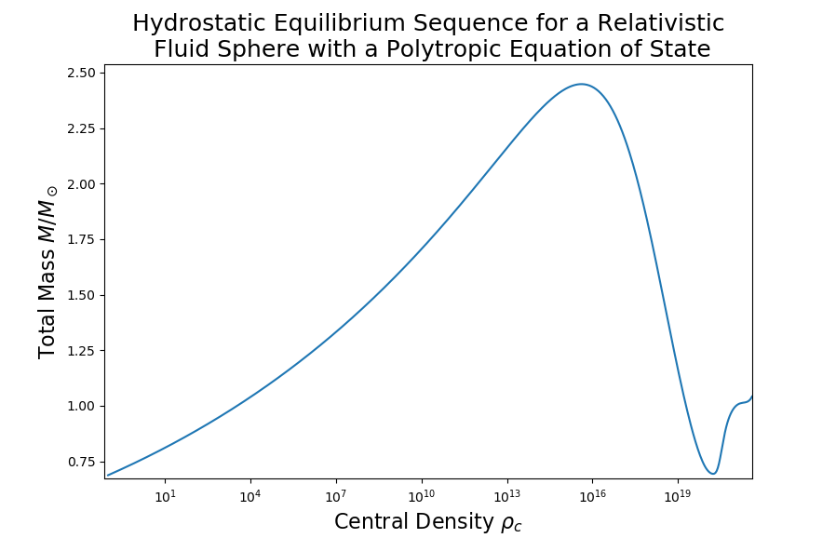



Fluid Sphere Neutron Star Model
Hydrostatic Equilibrium ($\ddot{R}=\dot{R}=0$): Fluid rest frame, meaning internal pressure balances external force of gravity
Maximum Mass
~ 2.45 M☉
Gravitational Force
Maximum mass corresponds to onset of dynamic instability
Internal Pressure $p(σ)$
Polytropic Equation of State:
Polytropic Index
$$p(σ)=Kσ^{γ}$$
Constant of Proportionality
Mass Density
10/28/2019
Canadian Undergraduate Physics Conference
3

Slide 4
Why Thin Shells?
Governing equations and equilibrium configurations are relatively simple
Fluid sphere equilibrium sequences require numerical integration of 2 parametrized equations of motion and several series expansions about the origin
Maximum mass link to onset of stellar instability is demonstrated easily using only undergraduate algebra and calculus
Fluid sphere model requires relativistic fluid perturbation theory
More accessible to introductory relativity students
Almost all results can be expressed analytically
10/28/2019
Canadian Undergraduate Physics Conference
4

Slide 5
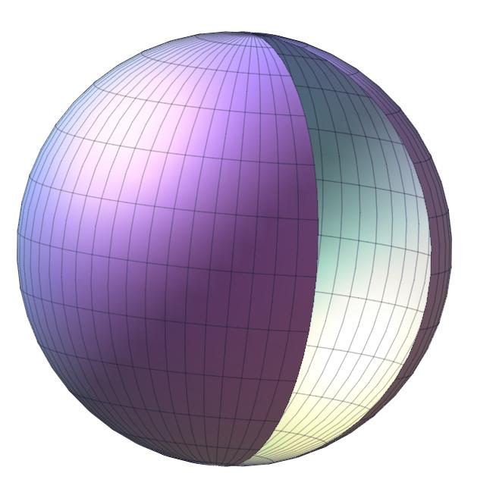

Thin-Shells
Interior Minkowski Geometry: Flat spacetime
Exterior Schwarzschild Geometry: Vacuum spacetime outside of a spherically-symmetric, uncharged, and static mass
Perfect-fluid (i.e. no heat conduction, shear stress, or viscosity) matter content of surface smoothly joins both geometries
We use the reference frame co-moving with the shell surface
The shell is macroscopically described by it’s compactness:
Schwarzschild Geometry
Thin Matter Shell
$$(τ,θ,φ)$$
Minkowski Geometry
Material Mass
$$C=\frac{m}{R}$$
Shell Radius
10/26/2019
Canadian Undergraduate Physics Conference
5

Slide 6
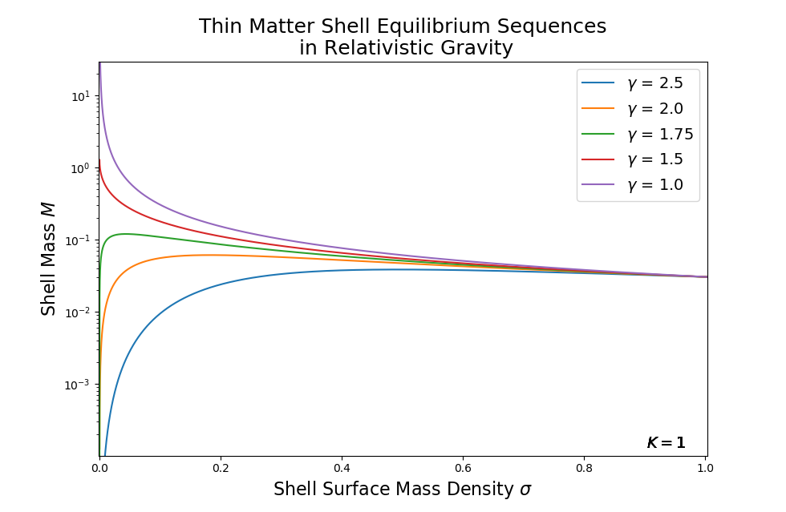
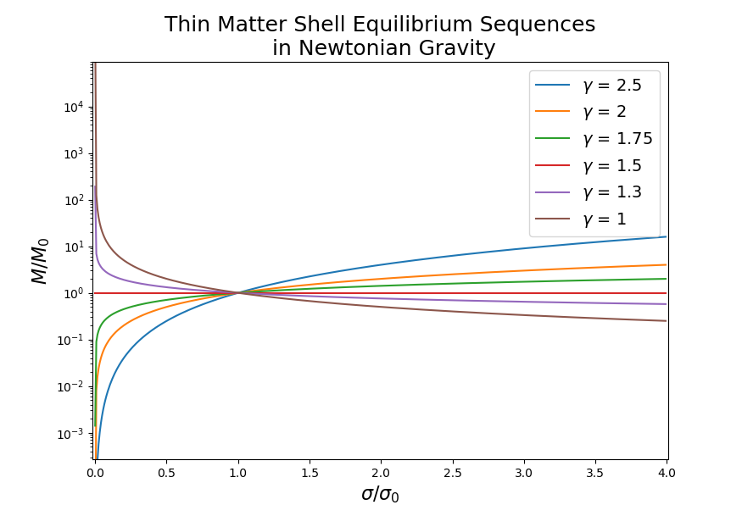





Hydrostatic Equilibrium for the Relativistic and
Newtonian Thin Matter Shells
Mass peaks,
$$\frac{dM}{dσ}=0$$
$$\frac{dM}{dσ}=0$$
$\frac{dM}{dσ}=0$ corresponds to a variable turning point:
$\frac{dM}{dσ}=0$ corresponds to a constant turning point:
$γ=\frac{3C^{2}−8C+6}{(C−1)(3C−4)}$
$$γ=\frac{3}{2}$$
10/26/2019
Canadian Undergraduate Physics Conference
6

Slide 7
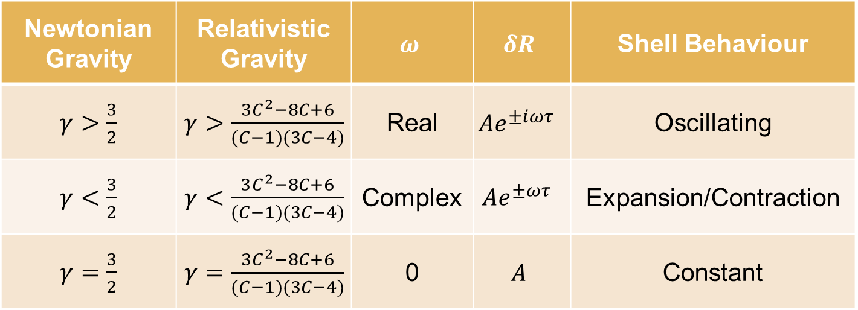
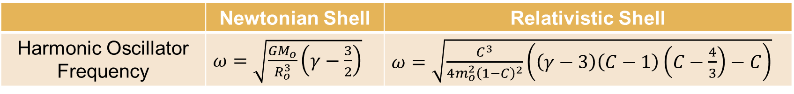


Stability Conditions
For small radial perturbations $\left|δR\right|≪1$ , the solution has the form of a harmonic oscillator:
$δR=Ae^{±iωτ}$ ,
where $A$is a constant determined by initial conditions ($τ=t$ in Newtonian regime).
 | Newtonian Shell | Relativistic Shell
Harmonic Oscillator Frequency | $ω=\sqrt{\frac{GM_{o}}{R_{o}^{3}}\left(γ−\frac{3}{2}\right)}$ | $ω=\sqrt{\frac{C^{3}}{4m_{o}^{2}{\left(1−C\right)}^{2}}\left(\left(γ−3\right)\left(C−1\right)\left(C−\frac{4}{3}\right)−C\right)}$
Newtonian Gravity | Relativistic Gravity | $$ω$$ | $$δR$$ | Shell Behaviour
$γ>\frac{3}{2}$ | $γ>\frac{{3C}^{2}−8C+6}{(C−1)(3C−4)}$ | Real | $$Ae^{±iωτ}$$ | Oscillating
$γ<\frac{3}{2}$ | $γ<\frac{3C^{2}−8C+6}{(C−1)(3C−4)}$ | Complex | $$Ae^{±ωτ}$$ | Expansion/Contraction
$γ=\frac{3}{2}$ | $γ=\frac{{3C}^{2}−8C+6}{(C−1)(3C−4)}$ | 0 | $$A$$ | Constant
$γ_{Rel}>γ_{Newt}$ to maintain shell stability since relativistic gravity is stronger than Newtonian gravity
For $C≪1→$ $γ≈\frac{3}{2}$ ; Newtonian gravity is recovered!
10/26/2019
Canadian Undergraduate Physics Conference
7

Slide 8
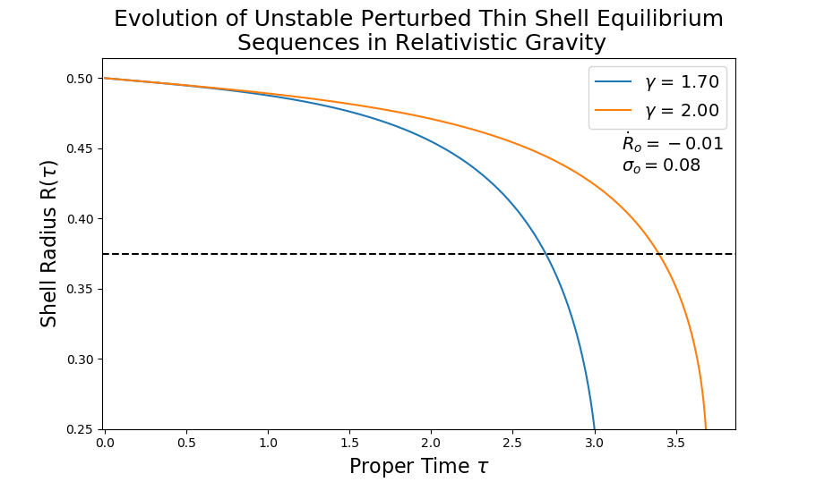
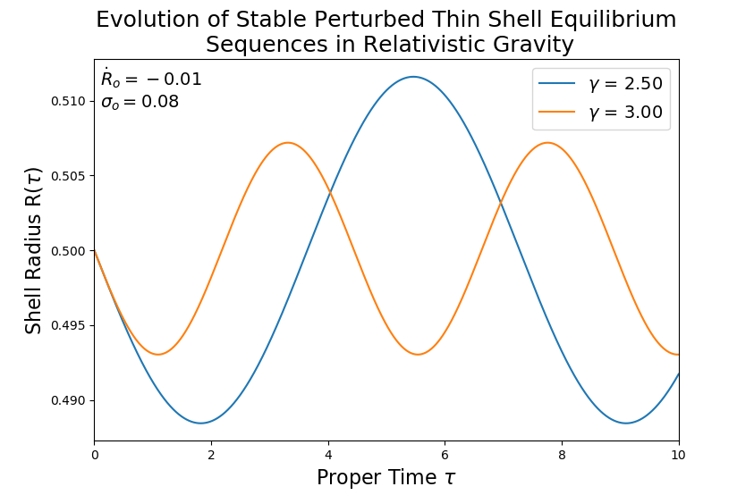



Thin-Shell Perturbations From Equilibrium
Limiting Radius
$$R_{s}=2M$$
For an unstable $γ$, thin-shell transitions to a black hole once the limiting radius is reached
For a stable $γ$, thin-shell oscillates until perturbed again
10/28/2019
Canadian Undergraduate Physics Conference
8

Slide 9
Further Analysis
Apply the methodology to a non-perfect fluid thin-shell
Explore the behaviour of concentric thin-shells and thin-shell crossings
Apply the methodology to a thin-shell connecting different geometries
Investigate different equations of state
Extend the research to higher and lower spacetime dimensions
10/26/2019
Canadian Undergraduate Physics Conference
9

Slide 10
Thank you for Listening!
Merci de Votre Attention!

Slide 11



Hydrostatic Equilibrium for the Relativistic and
Newtonian Thin Matter Shells
In relativistic gravity $\frac{dR}{dσ}=0$ corresponds to a variable turning point:
$γ=\frac{2−C}{1−C}$
Since we assume that $R$ should decrease for increasing $σ$, an upper bound for $γ$ is this turning point
In Newtonian gravity $\frac{dR}{dσ}=0$ corresponds to a constant turning point:
$$γ=2$$
11/3/2019
Canadian Undergraduate Physics Conference
11

Slide 12
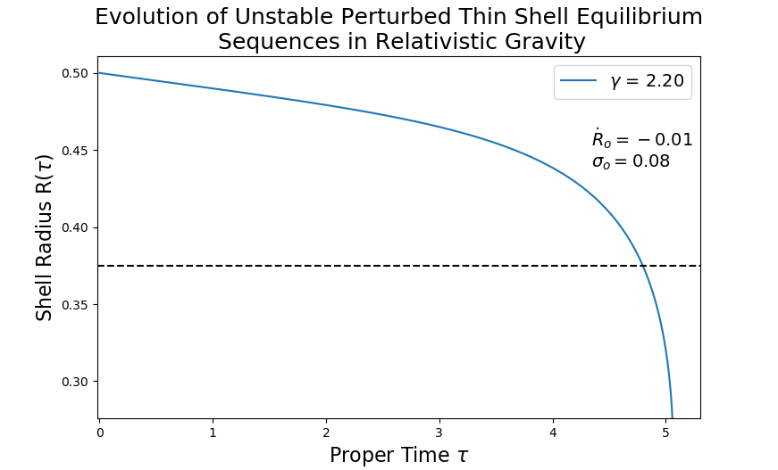

Thin-Shell Perturbations From Equilibrium
The ‘constant’ solution curve is unstable for larger perturbations
Limiting Radius
$$R_{s}=2M$$
11/3/2019
Canadian Undergraduate Physics Conference
12

